Slide 1

University Institute of Engineering
DEPARTMENT OF COMPUTER SCIENCE & ENGINEERING
Bachelor of Engineering (Computer Science & Engineering)
Subject Name : Machine Learning
Subject Code: CST-316
Topic: Evaluation of classifiers
Lecture-2.3.2
DISCOVER . LEARN . EMPOWER

Slide 2

Evaluating classification methods
Predictive accuracy
Efficiency
time to construct the model
time to use the model
Robustness: handling noise and missing values
Scalability: efficiency in disk-resident databases
Interpretability:
understandable and insight provided by the model
Compactness of the model: size of the tree, or the number of rules.

Slide 3
Evaluation methods
Holdout set: The available data set D is divided into two disjoint subsets,
the training set D_{train} (for learning a model)
the test set D_{test} (for testing the model)
Important: training set should not be used in testing and the test set should not be used in learning.
Unseen test set provides a unbiased estimate of accuracy.
The test set is also called the holdout set. (the examples in the original data set D are all labeled with classes.)
This method is mainly used when the data set D is large.

Slide 4
Evaluation methods (cont…)
n-fold cross-validation: The available data is partitioned into n equal-size disjoint subsets.
Use each subset as the test set and combine the rest n-1 subsets as the training set to learn a classifier.
The procedure is run n times, which give n accuracies.
The final estimated accuracy of learning is the average of the n accuracies.
10-fold and 5-fold cross-validations are commonly used.
This method is used when the available data is not large.

Slide 5
Evaluation methods (cont…)
Leave-one-out cross-validation: This method is used when the data set is very small.
It is a special case of cross-validation
Each fold of the cross validation has only a single test example and all the rest of the data is used in training.
If the original data has m examples, this is m-fold cross-validation

Slide 6
Evaluation methods (cont…)
Validation set: the available data is divided into three subsets,
a training set,
a validation set and
a test set.
A validation set is used frequently for estimating parameters in learning algorithms.
In such cases, the values that give the best accuracy on the validation set are used as the final parameter values.
Cross-validation can be used for parameter estimating as well.

Slide 7
Classification measures
Accuracy is only one measure (error = 1-accuracy).
Accuracy is not suitable in some applications.
In text mining, we may only be interested in the documents of a particular topic, which are only a small portion of a big document collection.
In classification involving skewed or highly imbalanced data, e.g., network intrusion and financial fraud detections, we are interested only in the minority class.
High accuracy does not mean any intrusion is detected.
E.g., 1% intrusion. Achieve 99% accuracy by doing nothing.
The class of interest is commonly called the positive class, and the rest negative classes.

Slide 8
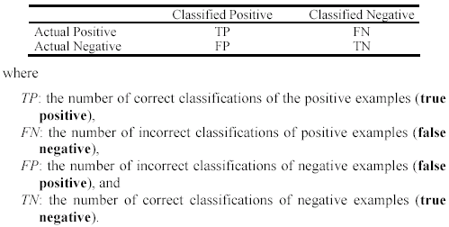
Precision and recall measures
Used in information retrieval and text classification.
We use a confusion matrix to introduce them.

Slide 9

Precision and recall measures (cont…)
Precision p is the number of correctly classified positive examples divided by the total number of examples that are classified as positive.
Recall r is the number of correctly classified positive examples divided by the total number of actual positive examples in the test set.

Slide 10

An example
This confusion matrix gives
precision p = 100% and
recall r = 1%
because we only classified one positive example correctly and no negative examples wrongly.
Note: precision and recall only measure classification on the positive class.

Slide 11
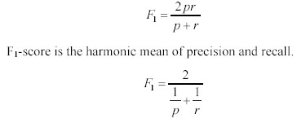
F1-value (also called F1-score)
It is hard to compare two classifiers using two measures. F₁ score combines precision and recall into one measure
The harmonic mean of two numbers tends to be closer to the smaller of the two.
For F₁-value to be large, both p and r much be large.

Slide 12


Receive operating characteristics curve
It is commonly called the ROC curve.
It is a plot of the true positive rate (TPR) against the false positive rate (FPR).
True positive rate:
False positive rate:

Slide 13


Sensitivity and Specificity
In statistics, there are two other evaluation measures:
Sensitivity: Same as TPR
Specificity: Also called True Negative Rate (TNR)
Then we have

Slide 14
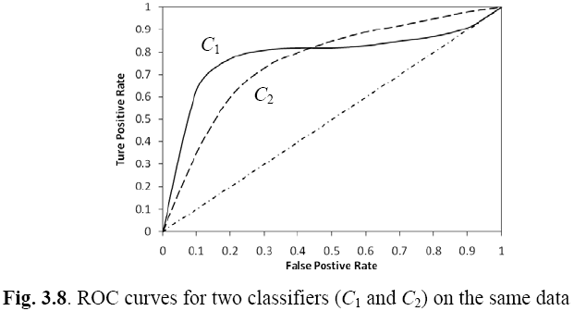
Example ROC curves

Slide 15
Area under the curve (AUC)
Which classifier is better, C₁ or C₂?
It depends on which region you talk about.
Can we have one measure?
Yes, we compute the area under the curve (AUC)
If AUC for C_{i} is greater than that of C_{j}, it is said that C_{i} is better than C_{j}.
If a classifier is perfect, its AUC value is 1
If a classifier makes all random guesses, its AUC value is 0.5.

Slide 16
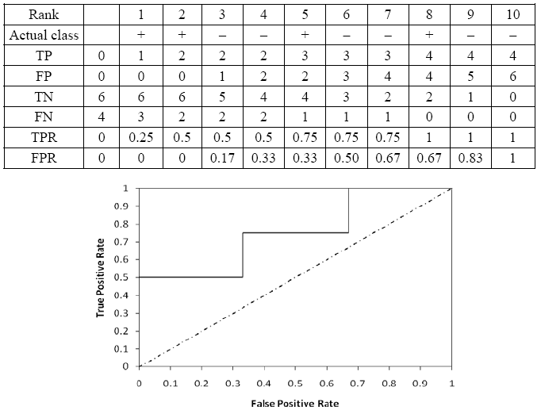
Drawing an ROC curve

Slide 17
Another evaluation method: Scoring and ranking
Scoring is related to classification.
We are interested in a single class (positive class), e.g., buyers class in a marketing database.
Instead of assigning each test instance a definite class, scoring assigns a probability estimate (PE) to indicate the likelihood that the example belongs to the positive class.

Slide 18
Ranking and lift analysis
After each example is given a PE score, we can rank all examples according to their PEs.
We then divide the data into n (say 10) bins. A lift curve can be drawn according how many positive examples are in each bin. This is called lift analysis.
Classification systems can be used for scoring. Need to produce a probability estimate.
E.g., in decision trees, we can use the confidence value at each leaf node as the score.

Slide 19
An example
We want to send promotion materials to potential customers to sell a watch.
Each package cost $0.50 to send (material and postage).
If a watch is sold, we make $5 profit.
Suppose we have a large amount of past data for building a predictive/classification model. We also have a large list of potential customers.
How many packages should we send and who should we send to?

Slide 20
An example
Assume that the test set has 10000 instances. Out of this, 500 are positive cases.
After the classifier is built, we score each test instance. We then rank the test set, and divide the ranked test set into 10 bins.
Each bin has 1000 test instances.
Bin 1 has 210 actual positive instances
Bin 2 has 120 actual positive instances
Bin 3 has 60 actual positive instances
…
Bin 10 has 5 actual positive instances

Slide 21
Lift curve
Bin 1 2 3 4 5 6 7 8 9 10

Slide 22
References
Books and Journals
Understanding Machine Learning: From Theory to Algorithms by Shai Shalev-Shwartz and Shai Ben-David-Cambridge University Press 2014
Introduction to machine Learning – the Wikipedia Guide by Osman Omer.
Video Link-
http://primo.ai/index.php?title=Evaluation_-_Measures
https://builtin.com/data-science/precision-and-recall
Web Link-
https://towardsdatascience.com/accuracy-recall-precision-f-score-specificity-which-to-optimize-on-867d3f11124

Slide 23
THANK YOU

